Slide 1
Hardware Design of
Real-time Classification Algorithm

Slide 2
Specification
The purpose of this project is to recognize a handwritten character image using the TRDM-D5M camera mounted on the DE1 FPGA board. The captured image will be processed by the hardware, namely the extended 552 processor with our assembly code.
The weight of the softmax linear classification is obtained using python pre-training algorithm and is preloaded into the ROM on the FPGA.
By using floating point matrix multiplication to process the image, we will obtain the predicted image category with high precision.
Finally, we will display the predicted image through UART to a host machine. An alternative would be displaying the classified result through VGA.

Slide 3
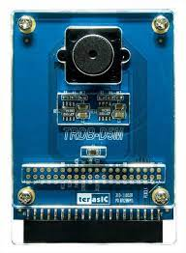
SW[9:0]
decode
CameraIN
LEDR[9:0]
clk
Spart
tx
Image_recognition.sv
BMP_display
key0
rst_n
Extended CPU
Monitor
rst_synch
clk

Slide 4
Note about multiplication
We will use * for single cycle 16 by 16 multiple, both signed and unsigned, in the beginning.
If this do not fit on the FPGA, we will proceed with the multi-cycle multiply as drawn in the next slide

Slide 5
16-by-16 Four-cycle Multiplier
mul0
16x4 single-cycle signed multiplier
Accumulator
mul1
start
Left shifter by 4
0
rdy
16x16_multiplier.sv
Mux
SM control
(counter)
32-bit adder
out
Notes:
[3:0] [7:4] [11:8] [15:12]

Slide 6
Floating Point Arithmetic
s
eeee_eeee
mmmm_mmmm_mmmm_mmmm_mmmm_mmm
Value = [(-1)^S] * (2^E) * (1.m), this 1 on the left of the decimal point is restricted to be 1
E is 16-bit signed, m is 15-bit unsigned (let M be 1.m), value sign depend on S
There is NO representation of absolute 0, but a number can be as small as ± 2^{-2^15}, which is very close to 0. After an addition, we also need to check for 0. If a 0 occurs, we need to set the number to 2^{-2^15}, which is 0x40000000 in this format. When dealing with negative numbers, we need to append the strict 1 in front of M, as “1.{M}”, then insert a 0 in front to indict the unsigness, as “01.{M}”. If the signed bit is set, then we convert the “01.{M}” into 2’s complement, then perform add. If the result is negative, then we convert it back to unsigned form and set its negative bit.
If any of the operands equals to 0x40000000, the result of multiplication is also 0x40000000, and the result of addition is the value of the other operand.
normalize(S, E, M) function - using shifters to ensure S, E, M follow FP definition
FP Addition V1 + V2: 1. Shift the smaller number to the right until the exponents of both numbers are the same. Increment the exponent of the smaller number after each shift. E’ represents the common E (the larger one)
2. Add M of each number as an integer calculation, M’ is the result of this step
3. S’ is determined by the number with larger abs
4. Vout = normalize(S’, E’, M’)
FP Multiplication V1 * V2: S’ = S1 ^ S2, E’ = E1 + E2, M’ = M1[15:0] * M2[15:0] Vout = normalize(S’, E’, M’)

Slide 7
Floating Point Adder
normalize
E1
Subtraction and comparator
Larger E
out
E2
diff
M1
Shift M with smaller E to right by diff bit
2’s comp
conversion
17-bit adder
M2
S1
FP_adder.sv
S2

Slide 8
Floating Point Multiplier
normalize
S1
1-bit XOR
S2
out
E1
16-bit signed adder
E2
M1
Append 1 to the left
16x16_multiplier.sv
M2
FP_multiplier.sv
Unsigned

Slide 9
IF
ID
IDEX
Fetch
Decode
Execute
Data
Mem
Write
Back
EX
MEM
MEM
WB
CPU.sv
Multi-cycle
Floating Operation
Multiplier
With Stalling Control

Slide 10
ISA
We expand the provided 552 ISA to a 32-bit one while maintaining the original 16-bit structure. All original instructions preserve their opcodes with an extra bit 0 added in MSB. All new instructions start with bit 1 for clear differentiation. The register file is also expanded to 32 registers with 5-bit selecting address. This expansion enables functions including floating-point operations, integer multiplication, stack management, and instruction read.
https://docs.google.com/spreadsheets/d/1PT7VjIhUPUwOg7ZNtqeGGRNTjavUGF0D/edit?usp=sharing&ouid=115717939913064443857&rtpof=true&sd=true
The next page also has a screenshot of the ISA

Slide 11
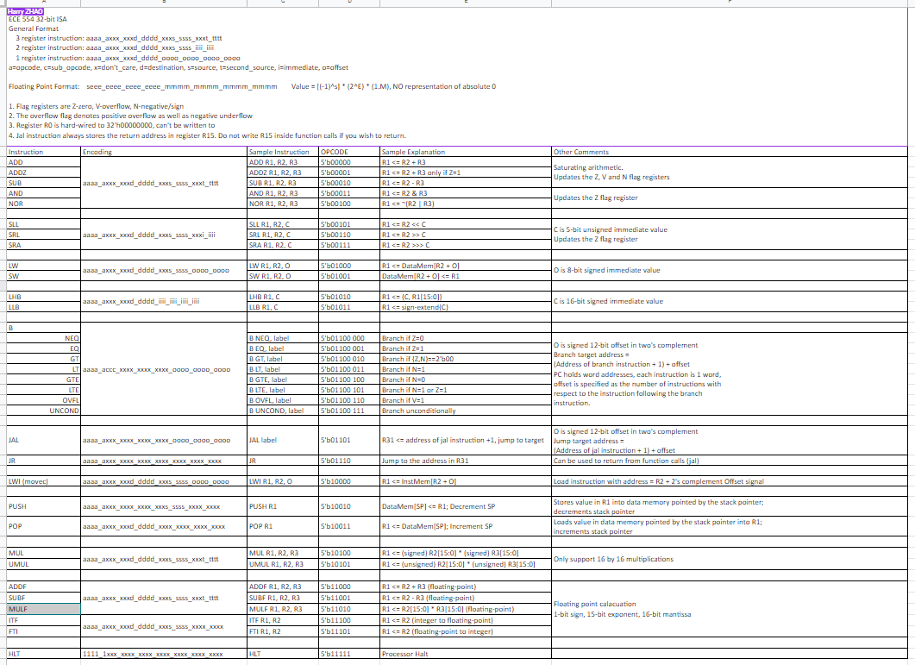

Slide 12
Possible Improvements
Specialized operation for the matrix multiplication on FPGA - we are considering the possibility of loading multiple data of the matrix and perform multiple multiplications simultaneously. (Tiny expansion of superscalar, VLIW, multi-cycle calculation)
Superscalar processor to perform the calculation of matrix multiplication (without Out-Of-Order schedule algorithm). This project would have little dependency in assembly code, so a superscalar processor could still perform well without OOO processing.
Out-Of-Order execution. This is the ultimate form of the project (unlikely to be accomplished). This will increase the performance of the classifier.

Slide 13
Division of Labor
High-level Image Classification Algorithm Training - Qikun Liu
Camera Interface and Assembly Code - Qikun Liu & Haining Qiu
Load weights into fpga - Qikun Liu
Assembler Modification for New ISA - Harry Zhao
Floating-Point Adder - Haining Qiu
Floating-Point Multiplier - Justin Qiao
Floating-Point Conversion and Normalizer - Justin Qiao
Processor Expansions - Harry Zhao
Unit Tests and Top-level Testbench Design - Everyone
Compiler - Qikun Liu
SuperScalar - Harry Zhao
Out of order processing - add reorder buffer - Haining & Justin
Out of order processing - add scheduler - Harry Zhao
Out of order processing - verification - everyone

